Slide 1


M.sc(Cs)-1 Sem-1 2021-22
By :
A46 Somnath Bhoite
A41 Sanket Dhanve
A29 Prathamesh Mengde
A60 Vaibhav Gaikwad

Slide 2
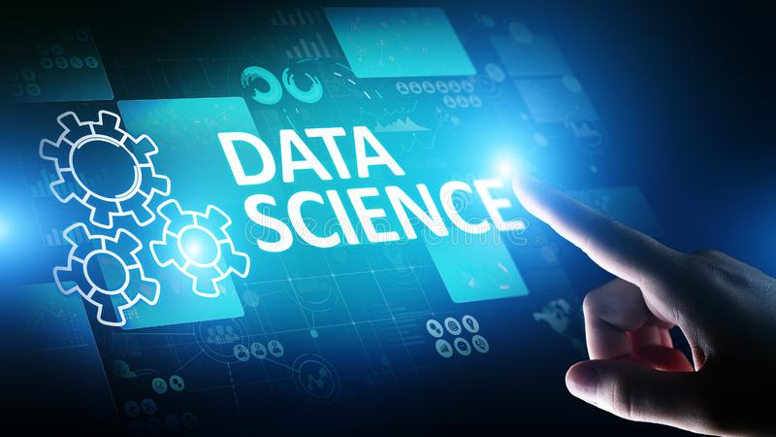
Data science
Data science is an interdisciplinary field that uses scientific methods, processes, algorithms and systems to extract knowledge and insights from noisy, structured and unstructured data, and apply knowledge and actionable insights from data across a broad range of application domains. Data science is related to data mining, machine learning and big data. Data science is a "concept to unify statistics, data analysis, informatics, and their related methods" in order to "understand and analyze actual phenomena" with data.

Slide 3
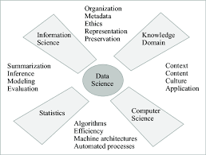
Foundations
Data science is an interdisciplinary field focused on extracting knowledge from data sets, which are typically large (see big data), and applying the knowledge and actionable insights from data to solve problems in a wide range of application domains.
The field encompasses preparing data for analysis, formulating data science problems, analyzing data, developing data-driven solutions, and presenting findings to inform high-level decisions in a broad range of application domains.

Slide 4
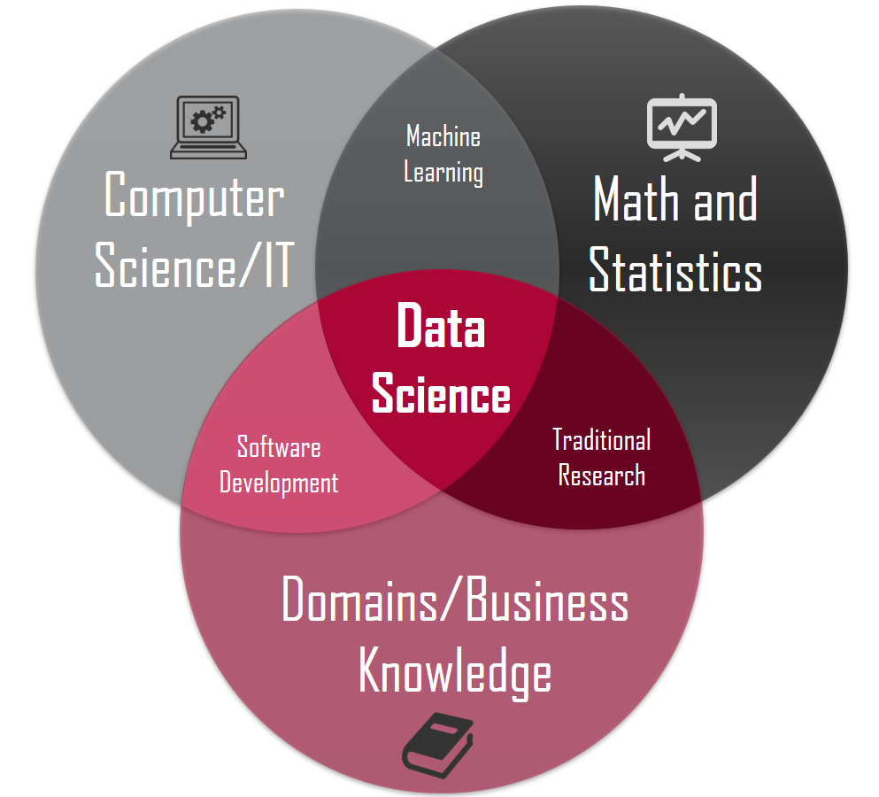
Relationship to statistics
Many statisticians, including Nate Silver, have argued that data science is not a new field, but rather another name for statistics.
Others argue that data science is distinct from statistics because it focuses on problems and techniques unique to digital data.
He describes data science as an applied field growing out of traditional statistics.data science can be therefore described as an applied branch of statistics.

Slide 5
Technologies and techniques
There is a variety of different technologies and techniques that are used for data science which depend on the application.
1)Linear regression :
In statistics, linear regression is a linear approach for modelling the relationship between a scalar response and one or more explanatory variables (also known as dependent and independent variables). The case of one explanatory variable is called simple linear regression; for more than one, the process is called multiple linear regression.
This term is distinct from multivariate linear regression, where multiple correlated dependent variables are predicted, rather than a single scalar variable.
In linear regression, the relationships are modeled using linear predictor functions whose unknown model parameters are estimated from the data. Such models are called linear models. Most commonly, the conditional mean of the response given the values of the explanatory variables (or predictors) is assumed to be an affine function of those values.

Slide 6
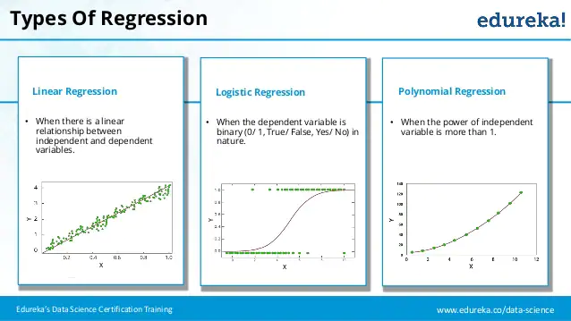

Slide 7
2) Logistic regression :
In statistics, the logistic model (or logit model) is used to model the probability of a certain class or event existing such as pass/fail, win/lose, alive/dead or healthy/sick. This can be extended to model several classes of events such as determining whether an image contains a cat, dog, lion, etc. Each object being detected in the image would be assigned a probability between 0 and 1, with a sum of one.
Logistic regression is a statistical model that in its basic form uses a logistic function to model a binary dependent variable, although many more complex extensions exist.
In regression analysis, logistic regression^{[1]} (or logit regression) is estimating the parameters of a logistic model (a form of binary regression).
Mathematically, a binary logistic model has a dependent variable with two possible values, such as pass/fail which is represented by an indicator variable, where the two values are labeled "0" and "1".
In the logistic model, the log-odds (the logarithm of the odds) for the value labeled "1" is a linear combination of one or more independent variables ("predictors"); the independent variables can each be a binary variable (two classes, coded by an indicator variable) or a continuous variable (any real value).

Slide 8
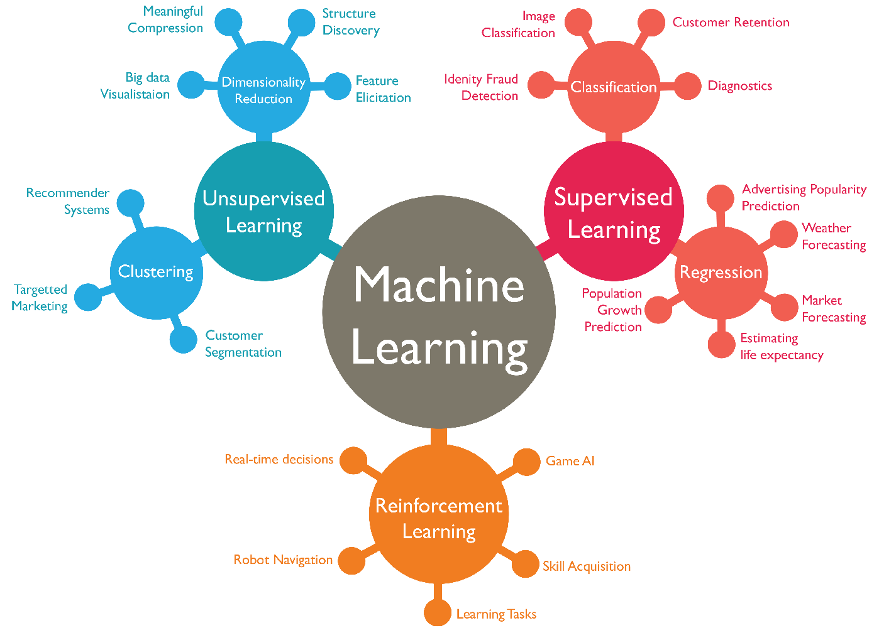
Machine learning
Machine learning (ML) is the study of computer algorithms that can improve automatically through experience and by the use of data.
It is seen as a part of artificial intelligence. Machine learning algorithms build a model based on sample data, known as training data, in order to make predictions or decisions without being explicitly programmed to do so.
Machine learning algorithms are used in a wide variety of applications, such as in medicine, email filtering, speech recognition, and computer vision, where it is difficult or unfeasible to develop conventional algorithms to perform the needed tasks.[

Slide 9
Etymology
Early usage :
In 1962, John Tukey described a field he called "data analysis", which resembles modern data science. In 1985, in a lecture given to the Chinese Academy of Sciences in Beijing, C.F. Jeff Wu used the term Data Science for the first time as an alternative name for statistics. Later, attendees at a 1992 statistics symposium at the University of Montpellier II acknowledged the emergence of a new discipline focused on data of various origins and forms, combining established concepts and principles of statistics and data analysis with computing.
The term "data science" has been traced back to 1974, when peter Naur proposed it as an alternative name for computer science.
2) Modern usage :
The modern conception of data science as an independent discipline is sometimes attributed to William S. Cleveland. In a 2001 paper, he advocated an expansion of statistics beyond theory into technical areas; because this would significantly change the field, it warranted a new name.
"Data science" became more widely used in the next few years: in 2002, the Committee on Data for Science and Technology launched Data Science Journal. In 2003, Columbia University launched The Journal of Data Science

Slide 10
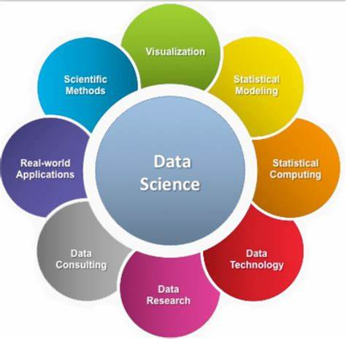

Slide 11
THANK YOU!!!!!

